Slide 1

Computer Graphics
CS C 471 and IS C 471
Dr. Lucy J. Gudino
Computer Science & Information Systems Group
Birla Institute of Technology & Science, Pilani, Goa Campus

Slide 2
3-D Transformations

Slide 3
Introduction…
3D Cartesian coordinate systems
Direction and magnitude along three axes, with reference to an origin
Locations are defined by x, y, z triples
Can define cubes, cones, spheres, etc., (volumes in space) in addition to all one- and two-dimensional entities
Objects are defined in three dimensions and presented in two dimensions
  picture should go through viewing coordinate transformations and projection routines
Notes:
Mention about the difference between 2D and 3D graphics
-2D graphics, no depth variations of the object w r t the viewer and was projected on 2D planar surface and all operations are carried out in xy plane. Operations performed are scaling, translation, rotation, shearing etc.
- 3D graphics system, there is a z component which represents the depth. 3D graphics system is needed to plot real time pictures.
- circle in 2 D -> sphere in 3 D, square in 2 D -> cube in 3D, Ellipse in 2D ->Ellipsoid in 3D. In case of 3D graphics system, projection geometry is very very important. note that projection geometry was not considered while rendering 2D objects. In 3D graphics, position of object wrt camera or eye is very important. Smaller object closer to camera looks bigger where as bigger object farther to camera looks smaller. This concept is known as fore shortening effect.

Slide 4
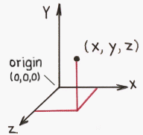
Introduction
  Diagram shows the x and y axis horizontally and vertically, respectively, then the z axis should be shown pointing "out of the page" towards the viewer or camera
  How to determine orientation of axes and direction of rotations ?
    Right-handed system
    Left-handed system
  Thumb = x axis
  Index up = y axis
  Middle out = z axis

Slide 5
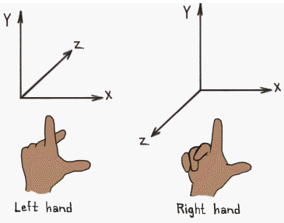
Right-handed system vs
Left-handed system
Most world and object axes tend to be right handed
Left handed axes often are used for cameras

Slide 6
3-D Objects

Slide 7
Glut models
glutSolidSphere()
glutSolidCube()
glutSolidCone()
glutSolidTorus()
glutSolidDodecahedron()
glutSolidOctahedron()
glutSolidTetrahedron()
glutSolidIcosahedron()
glutSolidTeapot()
glutWireSphere()
glutWireCube()
glutWireCone()
GlutWireTorus()
glutWireDodecahedron()
GlutWireOctahedron()
glutWireTetrahedron()
glutWireIcosahedron()
glutWireTeapot()

Slide 8
Drawing 3D objects
glutWireSphere() or glutSolidSphere()
render a solid or wireframe sphere respectively.
    void glutSolidSphere(GLdouble radius, GLint slices, GLint stacks);
    Void glutWireSphere(GLdouble radius, GLint slices, GLint stacks);
  radius: The radius of the sphere.
  slices: The number of subdivisions around the Z axis (similar to lines of longitude).
  stacks: The number of subdivisions along the Z axis (similar to lines of latitude).

Slide 9
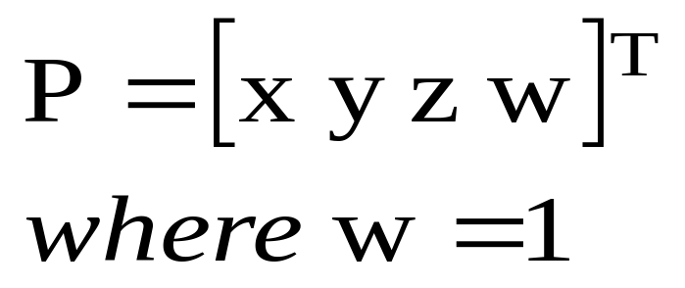
3D Representation of a point
All transformations will be represented using 4x4 matrices i.e.
P’ = T. P
where T is the transformation matrix

Slide 10
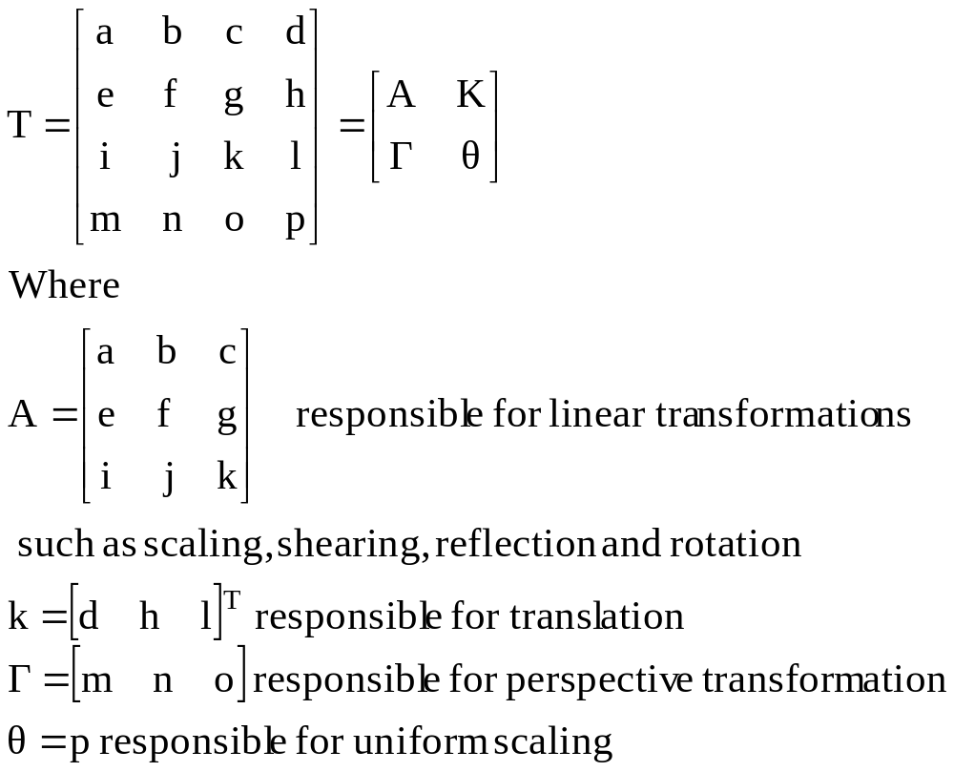
Transformation Matrix T

Slide 11
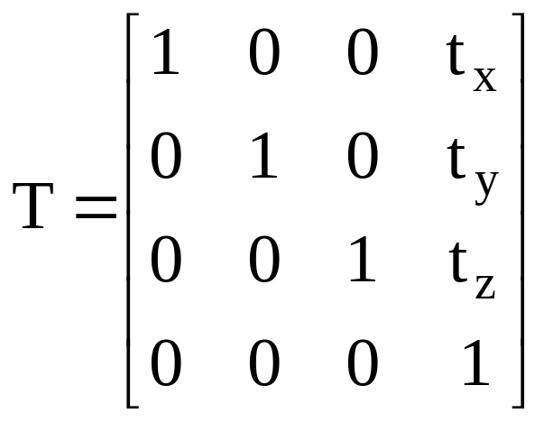
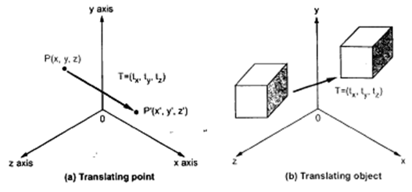
Translation

Slide 12
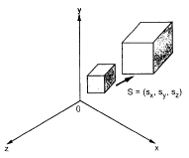
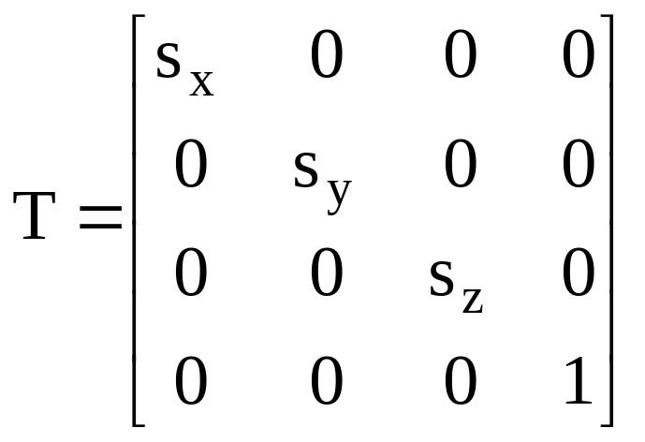
Scaling

Slide 13
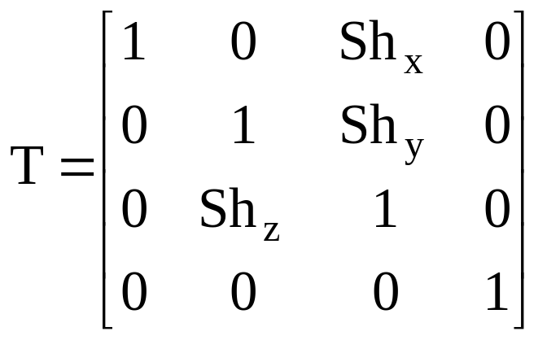
Shearing

Slide 14
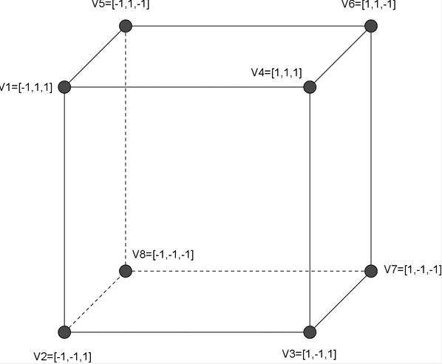
Example
Apply shear with sh_{x} =2, sh_{y}= 2 and sh_{z}= 2

Slide 15
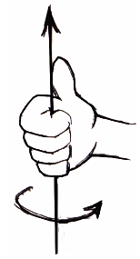
Rotation
For three dimensional rotation we need to specify an axis of rotation about which the object is to be rotated along with the angle of rotation
  axis of rotation
  angle of rotation
“Right Hand Rule" for rotations: grasp axis with right hand with thumb oriented in positive direction, fingers will then curl in direction of positive rotation for that axis
The positive value of angle θ indicates counter clockwise rotation

Slide 16
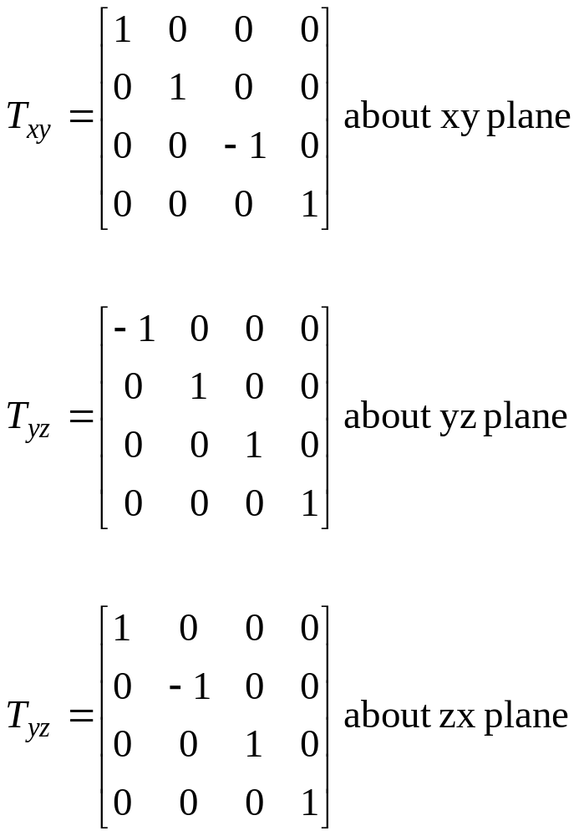
3D Reflections
In 2D reflection about a line where as in 3D reflection about a plane

Slide 17
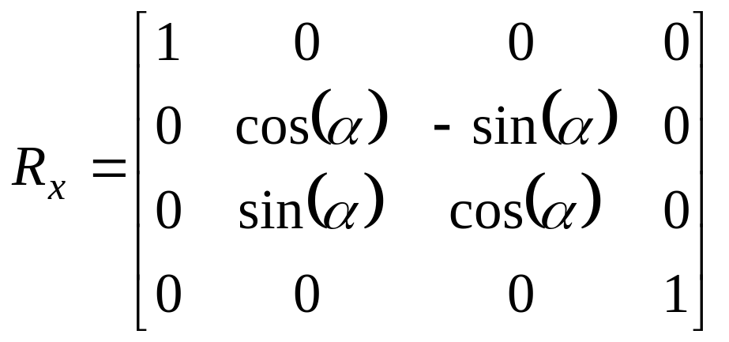
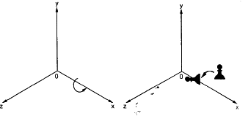
Rotation about x-axis
Rotation

Slide 18
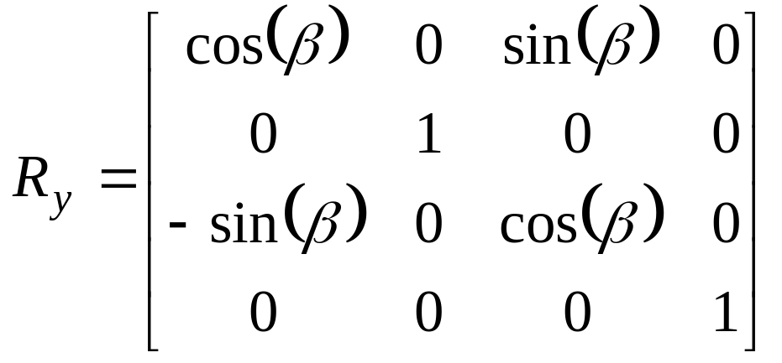
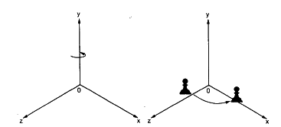
Rotation about Y-axis

Slide 19
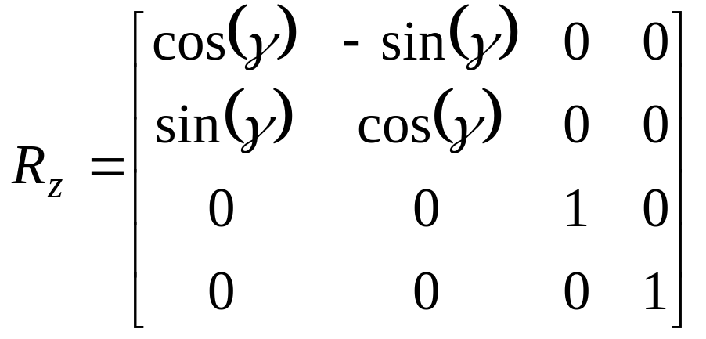
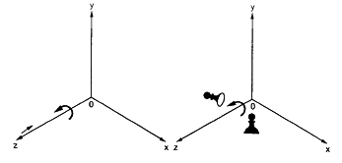
Rotation about Z-axis

Slide 20
Rotation about Arbitrary Axis
Two cases:
  Case I: object is to be rotated about an axis that is parallel to one of the coordinate axis
  Use following transformation sequence
    Translate the object so that the rotation axis coincides with the parallel coordinate axis
    Perform the specified rotation about the axis
    Translate the object so that the rotation axis is moved back to its original position

Slide 21

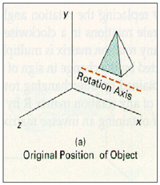
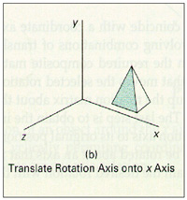
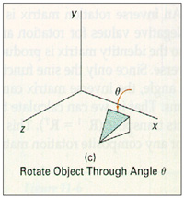
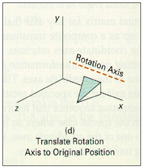
Contd…

Slide 22
Rotation about Arbitrary Axis
Case II
    If an object is to be rotated about an axis that is not parallel to one of the coordinate axes

Slide 23
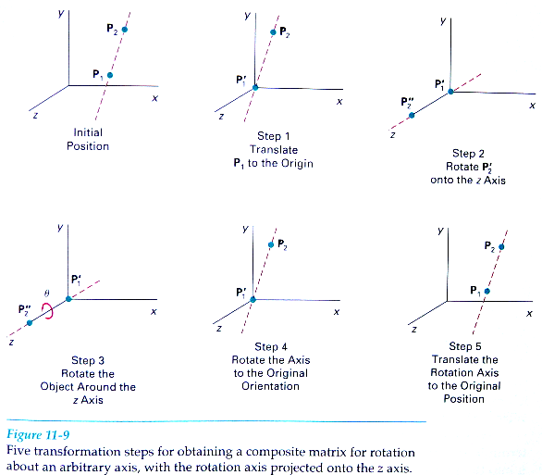

Slide 24
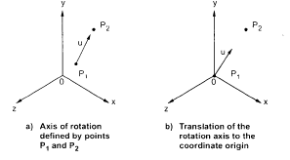
Contd…
  Use following transformation sequence
    Step 1: Translate the object so that the rotation axis specified by unit vector passes through the coordinate origin. ➔ Translate p1 to origin

Slide 25
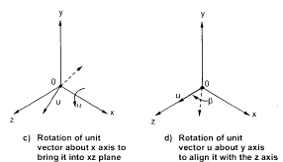
Contd…
  Step 2: Rotate the object so that the axis of rotation coincides with one of the coordinate axes. Usually the z axis.
    To coincide the axis of rotation to z axis we have to first perform rotation of unit vector u about x-axis to bring it into xz plane and then perform rotation about y axis to coincide it with z axis

Slide 26
Contd…
  Step 3: Perform the desired rotation θ about the z axis
  Step 4: Apply the inverse rotation about y axis and then about x axis to bring the rotation axis back to its original orientation
  Step 5: Apply the inverse translation to move the rotation axis back to its original position

